Slide 1
Chapter 13
How Do Web Applications Work?

Slide 2
Vannevar Bush, 1945
It affords an immediate step, however, to associative indexing, the basic idea of which is a provision whereby any item may be caused at will to select immediately and automatically another. This is the essential feature of the memex. The process of tying two items together is the important thing.
Notes:
http://www.theatlantic.com/magazine/archive/1945/07/as-we-may-think/303881/

Slide 3
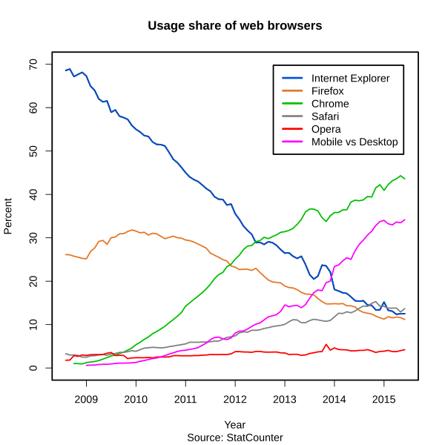
Browsers

Slide 4
Basis
Firefox: Gecko
Safari and Chrome (originally): WebKit
Chrome and Opera now: Blink

Slide 5
Earl
scheme:[//[user:password@]host[:port]][/]path[?query][#fragment]
Notes:
https://en.wikipedia.org/wiki/Uniform_Resource_Locator

Slide 6
Protocol
HyperText Transmission Protocol (Secure)
Simple protocol for the transmission of hypertext document
Get, head, post, put, delete
Uses TCP, MIME, etc.
Versions
1.0
1.1: “persistent” connections, better caching, etc.

Slide 7
Return Codes
1xx: informational
2xx: success
200 OK
3xx: redirect
301: moved permanently
302, 303: found, see other
304: not modified

Slide 8
Return Codes
4xx: client errors
400: bad request
403: not authorized
404: resource not found
5xx: server errors

Slide 9
Replies
Server may return a variety of documents
Suffix may specify type of file
Really: MIME header typically responsible
.html, .htm, .pdf, .jpg, .aspx, etc., etc.
Plugin might be required for rendering

Slide 10
Markup Languages
Generalized Markup Language
IBM, 1960’s
Goldfarb, Mosher, Lorie
Standard Generalized Markup Language (SGML)
1986

Slide 11
Markup Languages
eXtensible Markup Language (XML)
Document Type Definition (DTD)
XML schemas
Used for a lot of server to server data exchange
Many languages created
MathML, ChemML, BeerXML, etc.
JavaScript Object Notation (JSON) also used for messaging

Slide 12
HTML
Based on SGML and XML
Specified by the World Wide Web Consortium (W3C)
Current version: 5
XHTML passed over
Should not specify format
Only content
Content tagged

Slide 13
HTML Outline
<html>
<head>
<title>
</title>
</head>
<body>
</body>
</html>

Slide 14
HTML5
<video>, <audio>, <canvas>
<section>, <article>, <header>, <nav>
SVG
Compatible with HTML4 and XHTML
Though less draconian the XHTML
Handles document errors differently

Slide 15
HTML5 Features
The canvas element for immediate mode 2D drawing. See Canvas 2D API Specification 1.0 specification
Timed media playback
Offline Web Applications
Document editing
Drag-and-drop

Slide 16
HTML 5 Features
Cross-document messaging
Browser history management
Web Storage, a key-value pair storage framework that provides behavior similar to cookies but with larger storage capacity and improved API

Slide 17
Units
Different devices have different resolutions
Mobile different than laptops etc.
Pixels, percentages, em’s, points
For differing resolutions, use percentages or em’s

Slide 18
Style
Use Cascading Style Sheets (CSS)
Don’t use HTML “<i>, <b>”, etc.
Use to specify content
Don’t use inline
Can specify style for entire site in one place

Slide 19
Cascading
Order
Browser default
External style sheet
Internal style sheet (in the head section)
Inline style (inside an HTML element)
Final is combination of all four

Slide 20
Selectors
HTML element
Class
Starts with "."
Id
Starts with "#"
Media
Start with "@"

Slide 21
CSS Rule
selector [selector] [, selector] … {
property1: value1;
compositeProperty: value1 value2…;
…
}

Slide 22
MSU CSS
.header h1 {
margin: .2em 0;
font-size: 3em;
font-weight: 300
}

Slide 23
MSU CSS
@media only screen and (min-width: 320px) and (max-width: 768px) {
.mainBlueNavigation li button {
width: 40%
}
}
.mainBlueNavigation li button.btn {
color: #fff;
border: none;
background: #003663;
-webkit-transition: all .1 ease-in-out;
-moz-transition: all .1 ease-in-out;
-o-transition: all .1 ease-in-out;
transition: all .1 ease-in-out
}

Slide 24
JavaScript
Browser historically used request/response cycle
All processing done on server
Had to click “submit”
Feedback not immediate
Also: network and server slowness
Have browser do some processing

Slide 25
JavaScript
Netscape
LiveScript then JavaScript
Often used for form checking
Make sure all necessary boxes filled in, etc.
Becoming used to display anything at all
“Reactive” web sites
Mobile

Slide 26
JavaScript
Lots of good libraries
jQuery, Angular, Backbone, Bootstrap…
Used to extend browsers
Much of browser code in JavaScript
Now also being used on the server side
Node.js

Slide 27
AJAX
Originally: Asynchronous JavaScript And XML
Web client/server interaction historically synchronous
Client makes request on click, server responds
Asynchronous when request/response does not require click
Microsoft created “XMLHttpRequest”
Now, XML might not be used
JSON

Slide 28
AJAX
Much more compelling web sites
Information sent when needed
Queries give partial results

Slide 29
Search Engines
“Crawl” or “spider” web
Create indexes of words
And word combinations, etc.

Slide 30
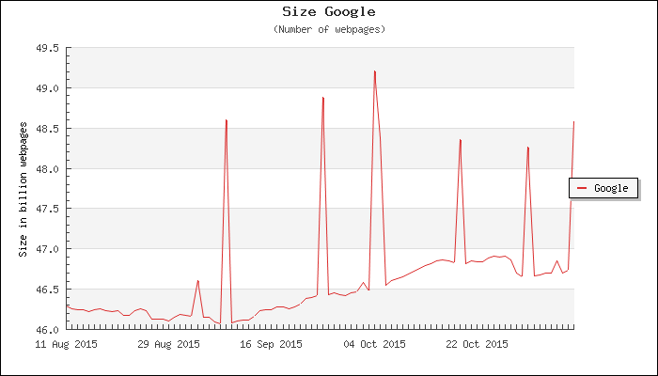
Number of Web Pages Indexed
Notes:
http://www.worldwidewebsize.com/

Slide 31
Page Rank
How pages reference each other
Highly ranked pages have lots of “in” links
The pages highly ranked pages refer to are ranked more highly
This is simplified
More than 200 factors are used

Slide 32
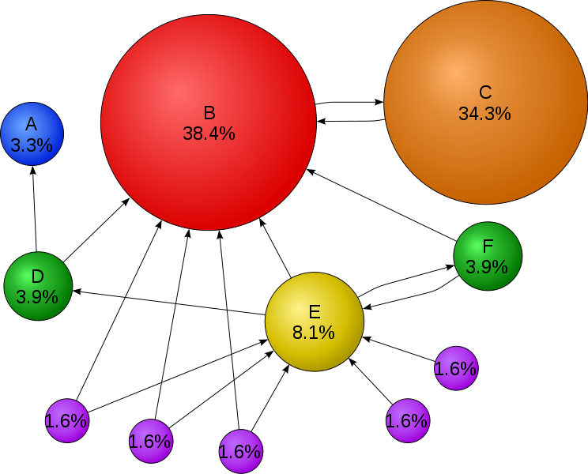
Page Rank Illustrated
Notes:
https://en.wikipedia.org/wiki/PageRank

Slide 33
Other Factors
Click popularity
Crowd sourcing
Stickiness
How fast do searchers come back?
Search Engine Optimization

Slide 34

Remember

Slide 35
Remember
Anyone can post anything
Very little is filtered or vetted
Check with snopes or other reliable source before believing anything

Slide 36
Popups
Used for advertising etc.
Can run on most any browser event
Page load, roll over, click, etc.
Many web browser offer protection
Addon’s too

Slide 37
Tracking
Lots of sites track you via cookies, invisible images, etc.
https://www.eff.org/privacybadger
https://www.ghostery.com/our-solutions/ghostery-add-on/
https://noscript.net/

